Slide 1
CEIBS: Win-win Collaboration
Dr. Yuan Ding , Vice President and Dean
China Europe International Business School www.ceibs.edu

Slide 2


Brief Overview of CEIBS
 | CEIBS was established in Shanghai on November 8, 1994. Non-profit joint venture between Chinese Government and the European Union. Receives financial support from Municipal Government of Shanghai and the European Union (50/50JV). Joint venture partners are Shanghai Jiaotong University and EFMD (European Foundation for Management Development).

Slide 3
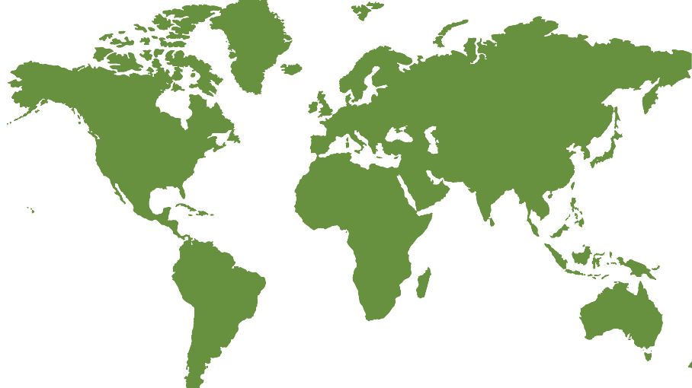
CEIBS Today
One school, three continents, and five locations.
Beijing Campus
Zurich, Switzerland
Shanghai Campus
Shenzhen
Accra, Ghana
Notes:
3

Slide 4
The mission of an international business school is to educate business leaders who has right value and strong capability to realize win-win in the evolving multi-culture environment.

Slide 5
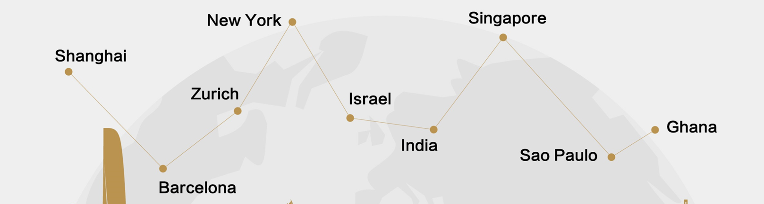
CEIBS’ Global EMBA (GEMBA) Programme:
  GEMBA Asia, Shanghai, September 4, 2016
  GEMBA Europe, Zurich, September 26, 2016
  Global modules in 5 continents
  Educating business leaders in the world for China
  Platform for international exchange

Slide 6
CEIBS’ Global EMBA Class in Shanghai:

Slide 7
CEIBS’ Global EMBA Class in Zurich:
Participants from 6 nationalities | Participants from 11 cities
China 10 | Abuja 1
Ghana 3 | Accra 4
Guinee-Bissau 1 | Beijing 1
Nigeria 10 | Bissau 1
Switzerland 4 | Dublin 1
Turkey 1 | Lagos 7
 | Lausanne 1
 | Qingdao 1
 | Shaanxi 1
 | Shanghai 5
 | Zurich 4

Slide 8

CEIBS’ Other Initiatives to Catch the Wind:
Centre for Globalisation of Chinese Companies
European Study Tours
Cooperation with business school in Warsaw
European forums

Slide 9
THANKS
2016.10

