Slide 1
Engineering Collaboration Sri Zaheer Dean and Elmer L. Andersen Chair in Global CSR
The 6th International Business School Shanghai Conference
October 17, 2016

Slide 2
Inter-collegiate collaboration
Education
Research
Easy
Hard
Dual Degrees MBA + Applied Economics, Human Resources, JD, MD, Healthcare Admin, Public Policy, Business Analytics, Pharmacy
Large scale cross-listed courses
Medical Industry Valuation Lab
Integrative Leadership
One college offering courses specifically for another
New Product Development
Entrepreneurship for Music majors
Anatomy & Physiology for Managers
Joint programs
MINCORPS “START UP” course
Management of Technology
Individual partnerships
Joint infrastructure
Maker Spaces
Large-scale programmatic research

Slide 3
Some examples of what’s working and why
Easy
Hard
New Product Design & Business Development
Medical Industry Valuation Lab
MIN-Corps & STARTUP
Food & Agriculture Partnership

Slide 4
New Product Design & Business Development
Collaboration with College of Science and Engineering connects leading companies with graduate students to develop new products.
Notes:
Started 20 yrs ago and still one of the most popular courses today. Puts MBA students in collaboration with engineers.
The New Product Design and Business Development program connects leading companies with exceptional University of Minnesota graduate students to develop valuable new products.
Throughout a 9-month project cycle, each client company sponsors a team of engineering and business students in connection with a specific product. Drawing on guidance from their client, faculty coaches, and industry advisors, student teams work independently to conduct background research, and to develop a working prototype and an accompanying business plan, which the client then carries forward to launch.
Student participants acquire hands-on experience in new product development, technology management and business creation.
Discover how engineering and business intersect to inform successful new products
Get valuable work experience to share with future employers
Practice tools from the classroom in a real-world environment
Lead development of an action plan for the client organization with potential for implementation
The University of Minnesota partners with organizations of all kinds to provide hands-on learning opportunities for students that result in innovative new products.
Get a working prototype and accompanying business plan for a new product
Tap expertise from graduate-level students who offer cross-functional knowledge in a variety of disciplines
Generate new insights about the marketplace
Collaborate with the project team to refine the solution
http://carlsonschool.umn.edu/departments/strategic-management-entrepreneurship-department/academic-programs/new-product-design

Slide 5
MIN-Corps
Joint initiative to increase research-based technology commercialization capabilities and activities across the University of Minnesota.
Run a “start-up” course, bootcamps and workshops for students across the U
Notes:
With funding from the National Science Foundation, MIN-Corps is a joint initiative of three areas of the University of Minnesota: the College of Science and Engineering, the Office for Technology Commercialization, and the Holmes Center for Entrepreneurship at the Carlson School of Management.
MIN-Corps offers a variety of short-term, non-credit bootcamps and workshops aimed at catalyzing technology commercialization across the University of Minnesota.
Students and researchers use the STARTUP course to test business model assumptions. By meeting with potential customers and partners, participants make the first step towards technology commercialization.
From Stavig:
MIN-Corps also includes a broader range of industry specific workshops and events (see attached Fall schedule). Overall, MIN-Corps teams have evaluated more than 200 concepts, of which 11 have been selected as finalists in MN Cup. Beyond the STARTUP funding, another 6 MIN-Corps teams have received initial $50K grants from the NIH (and are each eligible for another $100K). The "Stories" section on the web site offers a number of anecdotes.
The partnership with CSE and OTC has been tremendous - largely due to the excellent work by Carla - and is very unique among large universities.
Here are some highlights: Out of the 150 former STARTUP participants, over half continued with their businesses beyond the scope of the class, and over one third are still actively working on their ventures.
Our results are beginning to accelerate. From our Spring 2016 cohort, two participants Asiya and Berd Spokes won their divisions in the 2016 Minnesota Cup venture competition, while Sironix Rewables won a Phase I SBIR grant. (Not in this report, but notable, is that Minnealloy, who we sent to an I-Corps program in Detroit, also won its MN Cup division.)
60 program participants completed an in-depth survey about the course. Of those respondents, about 1/3 came from the Carlson School and the rest came from other parts of the University.
Collectively, these respondents have raised over $6.2 million in funding, with several businesses earning revenues up to $1 million in the last year alone. Collectively, these businesses employ over 40 full-time and 100 part-time employees. Close to 90% are based in Minnesota.
The overall feedback from our participants was positive, with a net promoter score of 64, meaning that the vast majority would recommend the course to a colleague.

Slide 6
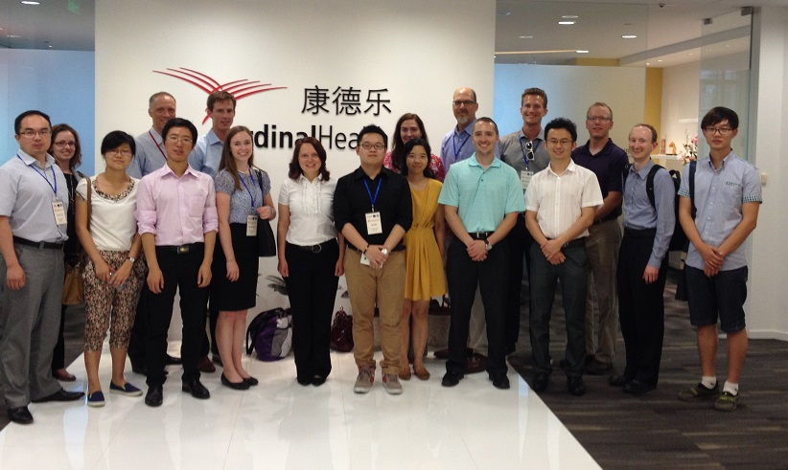
Medical Industry Valuation Lab
2014 Collaboration with University of Shanghai for Science and Technology to conduct market valuations for new medical technologies.
Notes:
The Medical Industry Valuation Lab at the Carlson School of Management was created to address the issue of great technologies not being commercialized and languishing within universities. Its founders saw an opportunity to address this issue through a unique experiential learning course for graduate students at the Carlson School and seven other University of Minnesota colleges.
With the launch of the Global Valuation Lab – a pilot program that concluded this past summer – the Carlson School furthered the lab’s reach and impact by conducting the valuation in one of the world’s leading hubs for medical technology innovation. It also infused a cross-cultural component to the training and offered students in the medical technology industry a training opportunity that would help them to pursue more global career paths.
The Global Valuation Laboratory is a new graduate class at the Carlson School that was offered in collaboration with the University of Shanghai for Science and Technology. The course took the students to China to work in cross-cultural teams performing rapid production market analysis to determine potential for success in global markets. In the course of a semester, the students delivered an elevator pitch for a new innovation, researched intellectual property rights, sized up potential markets, made written and verbal investment analyses, and counseled clients on whether to move ahead with the idea.
The majority of the students taking the Valuation Lab course are from the MBA Program, however, there are students from nursing, medicine, law, engineering and information technology programs thanks to memorandums of agreement with eight collegiate units at the University of Minnesota. The Global Valuation Lab in China also included a Carlson Executive Education participant.
The course syllabus and student schedule for the Global Valuation Lab trip to China are included as attachments.

Slide 7
Food and Agriculture Partnerships
Carlson School alum developed an irrigation business in India as part of interdisciplinary course.
Notes:
Initiatives that have come to fruition through collaboration with CFANS:
1. Dual-degree MBA/M.S. Applied Economics. The Carlson School and CFANS now jointly offer a signature opportunity for students to blend curriculums and draw on areas of excellence in both colleges—culminating in the first dual-degree offering between the two colleges.
2. New coursework in “traditional” Full- and Part-time MBA and M.S. Applied Econ. In spring 2016, Carlson and CFANS offered their first joint elective specifically for students interested in food and agribusiness—an “Agribusiness Marketplace” overview/survey course. The colleges are also more aggressively supporting student clubs to connect and engage those interested in food and agribusiness (example: Part-time MBA Student Commodities Club).
3. Agribusiness emphasis in new M.S. Supply Chain Management program. In fall 2016, Carlson launches a new one-year graduate degree targeted to working professionals seeking leadership roles in supply chain management. The curriculum includes coursework in Food & Ag (farm-to-fork), Negotiations, Quality & Security, Logistics & Transportation, Data Analytics, and other areas relevant to agribusiness.
4. Executive education. The Carlson School is the leading local provider for open-enrollment courses and custom programs that are frequently utilized by food and agribusiness companies as professional development opportunities for rising talent.
5. Minnesota Cup’s Grow North initiative. MN Cup is a startup competition and hub to connect Minnesota’s entrepreneurial ecosystem. Entering its twelfth year, it is the country’s largest statewide startup competition with over 10,000 participants. Finalists have raised nearly $200 million to spur innovation and job creation in our state. MN Cup is launching it’s Grow North initiative to connect food entrepreneurs with experts, thought leaders, advocates, enablers, resources and one another to develop ideas and talent in the state. Grow North can push Minnesota to become the leading community for entrepreneurs looking to begin a food business.
6. “Grand Challenges” sustainability course. Expanded research and coursework addressing grand challenges is a key component of the U’s strategic goal to create a more agile, integrated, and deeply engaged 21st-century research university. Grand Challenges courses address global issues through a solution-driven, interdisciplinary approach to learning--taught by cross-disciplinary instructors. Two of these new courses (Can we feed the World without destroying it?; Sustainability of Food Systems) focus on developing a foundational set of knowledge, skills, and values around the topic of sustainability.
7. Technological innovation in growing food, processing food, new products, and food safety. CFANS’ departments of Food Science & Nutrition and Bioproducts & Biosystems Engineering are recognized research leaders in their disciplines and home to nationally recognized faculty. They are at the fore-front of developing cutting-edge technology solutions addressing food safety and security.
8. Marketing Cluster. Courses are being offered at the undergraduate and graduate level in commodity marketing, food marketing, and horticultural marketing.

Slide 8
Tips for Engineering Collaboration
Much of your early reaching out might yield "they're not that into us" results. You have to focus in on those who are...
Trust and goodwill are critical in the early stages so TOP leadership has to be bought in from the start.
There must be something in it for everyone. This can be curricular, relational, financial etc. But there have to be somewhat clear positive outcomes for both sides.

